Slide 1

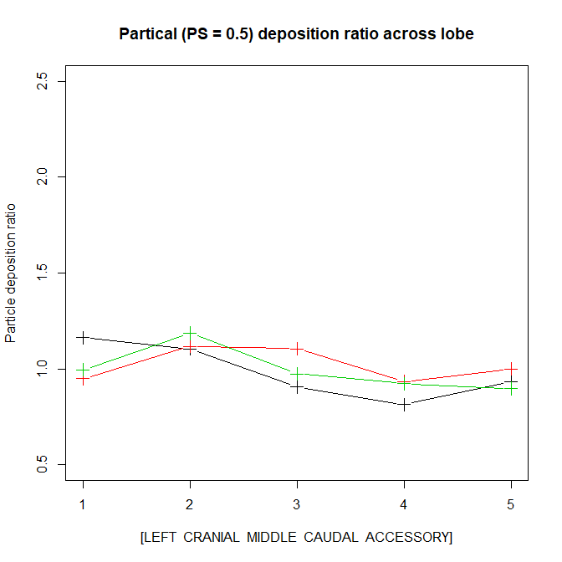
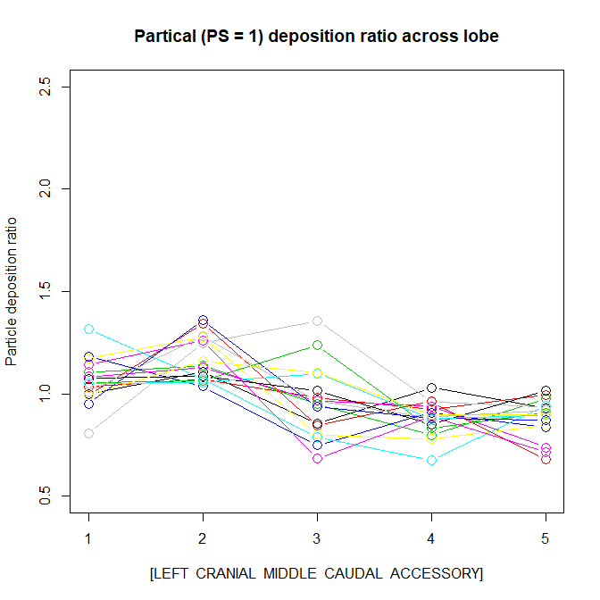
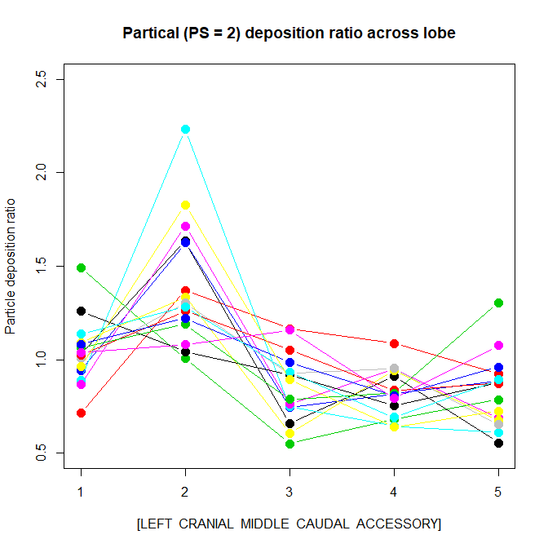
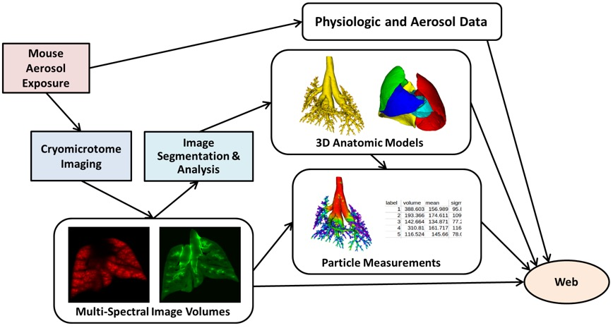
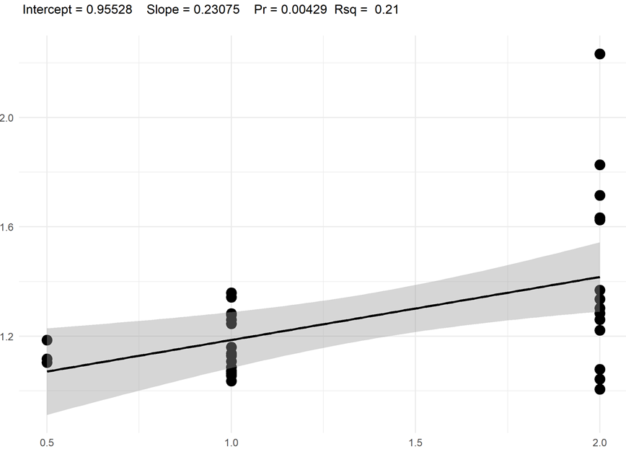
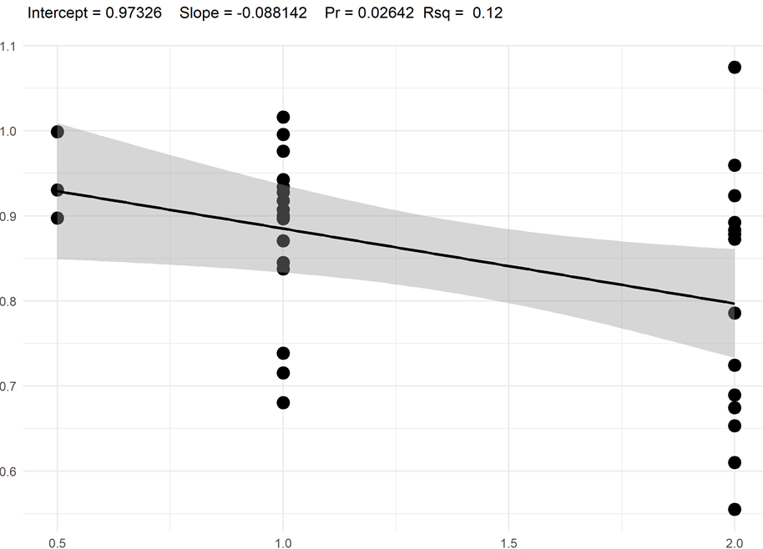
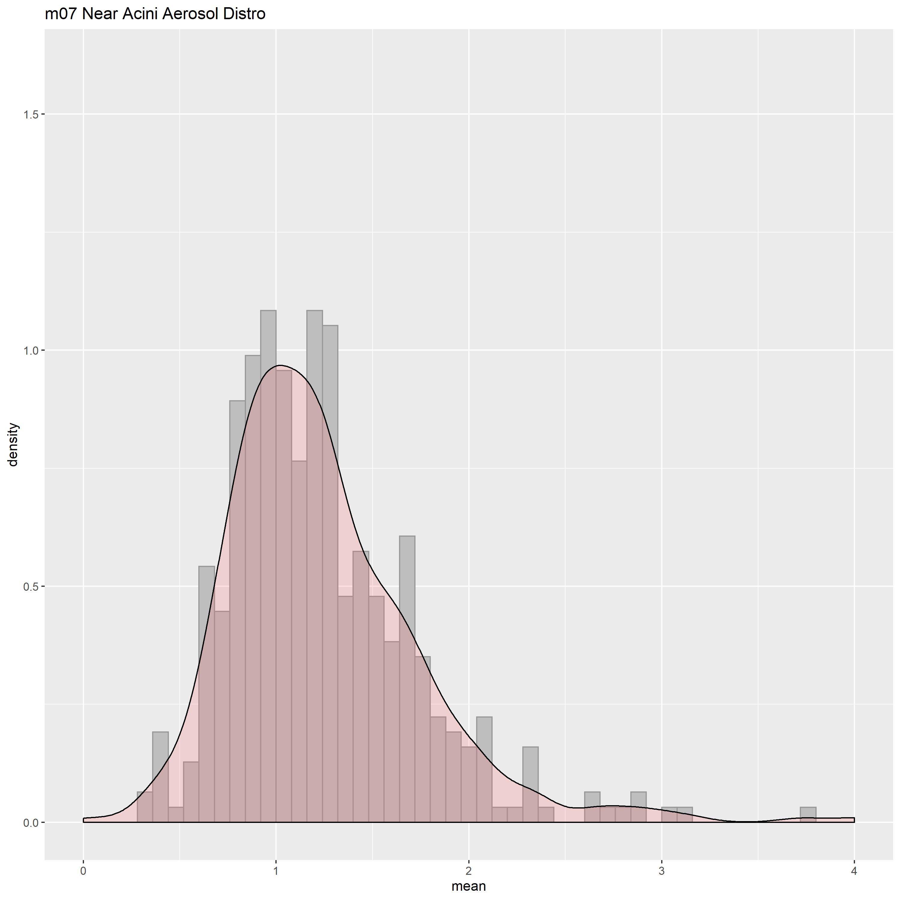
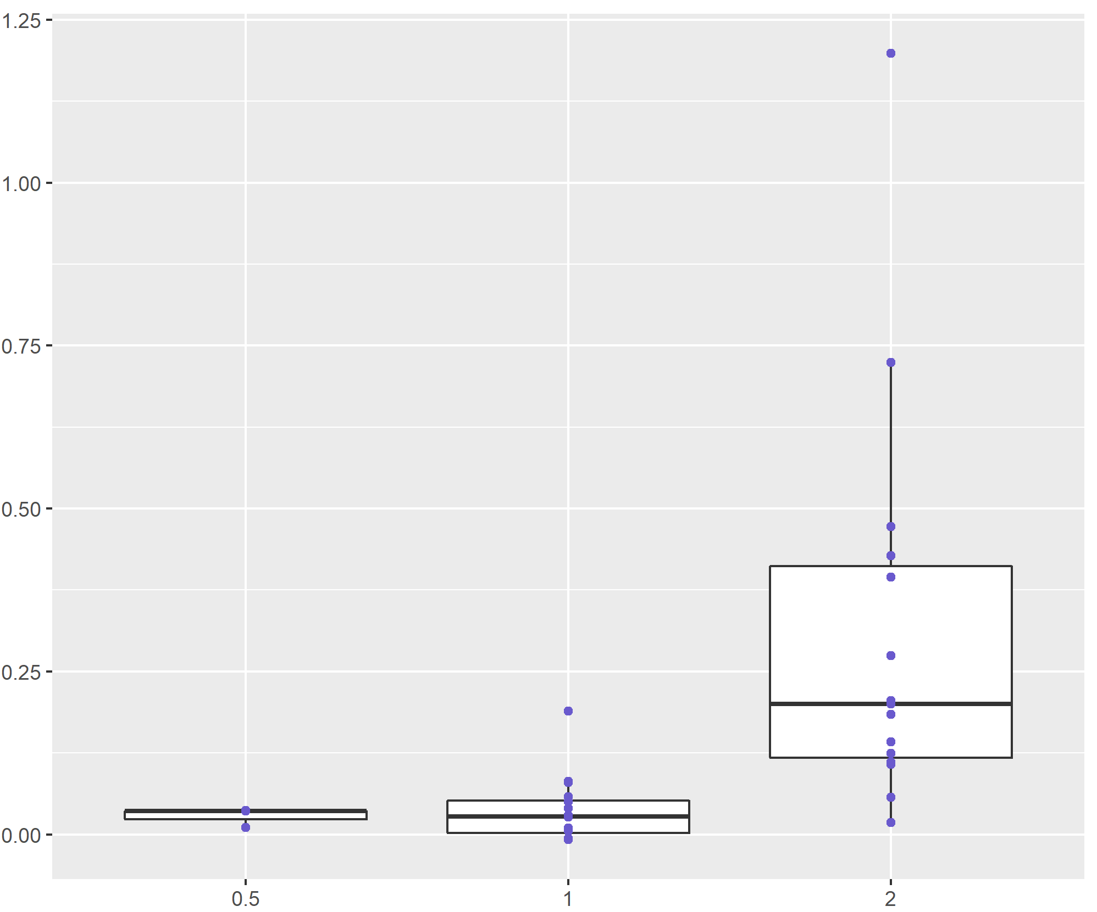
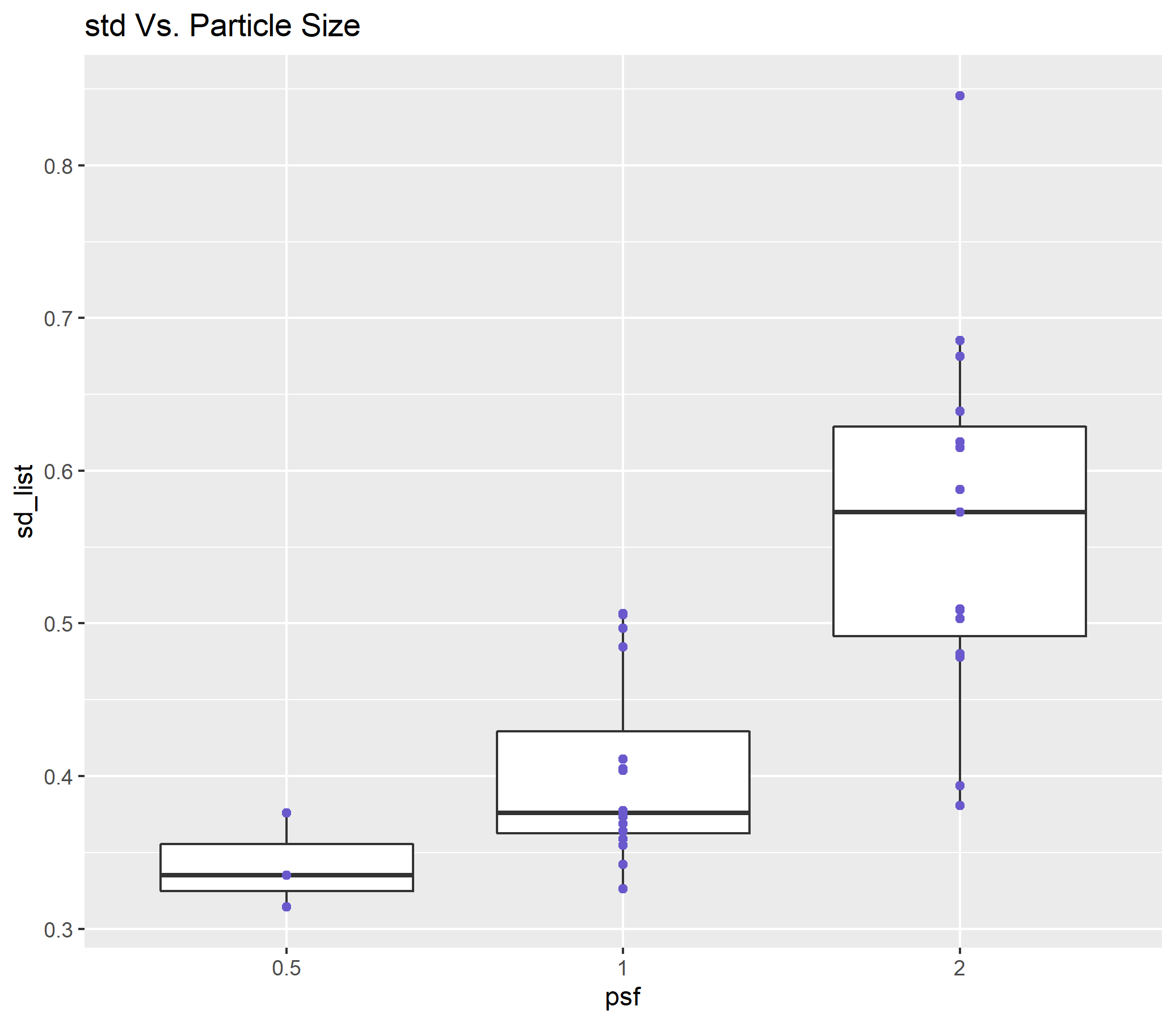


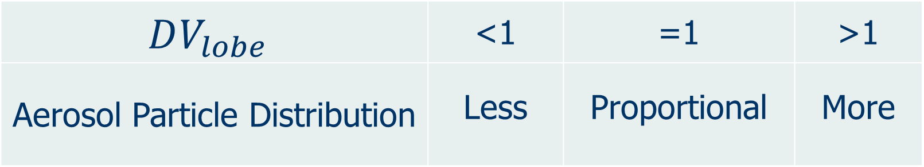
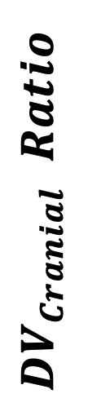
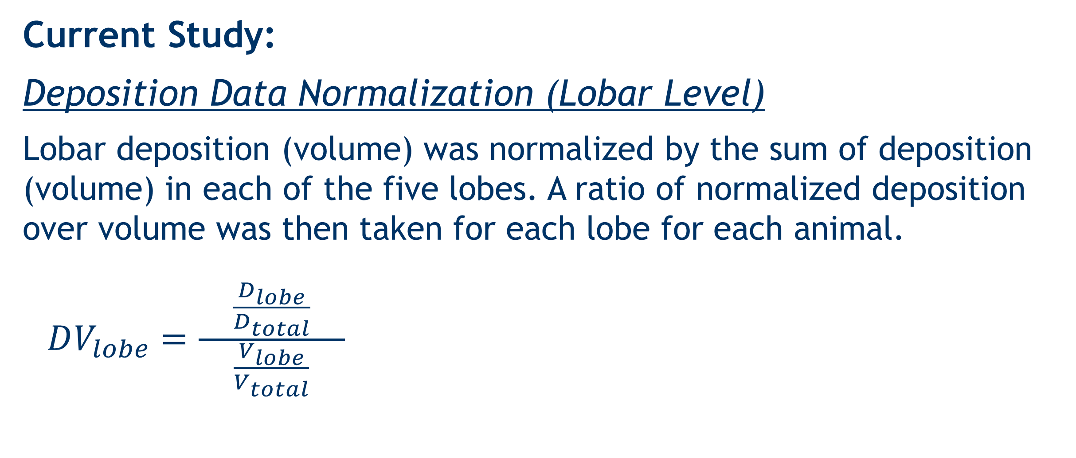
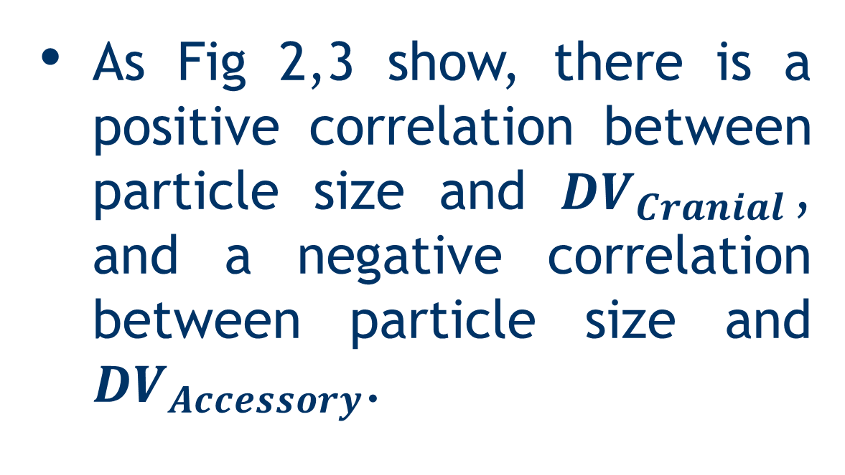

Lobar deposition of inhaled aerosol in the mouse lung: preliminary analysis of the LAPD dataset Wanjun Gu, Chantal Darquenne Department of Medicine, University of California, San Diego
BACKGROUND
RESULTS AND DISCUSSION
Aerosol-inhalation drug delivery research, due to its potential health risk, is usually carried out on laboratory animals, most commonly mice.
A unique database, Lung Anatomy + Particle Deposition Mouse Archive (LAPD) has been recently made available to the research community. This dataset includes both high resolution lung anatomy and deposition data in four strains of mice.
One of the major constraints of previous studies in this field has been lack of data on both lung anatomy and deposition distribution in the same animals.
Particle Size = 0.5 micron
DV Ratio Across Lobe
Particle Size = 1 micron
Particle Size = 2 micron
DV Ratio
Left
Cranial
Middle
Caudal
Accessory
Left
Cranial
Middle
Caudal
Accessory
Left
Cranial
Middle
Caudal
Accessory
OBJECTIVES
Fig 1
Heterogeneity in particle deposition increases with respect to increasing particle size (Fig. 1).
As shown in table 1, in general cranial lobe receives more particle deposition whereas Caudal, Middle and Accessory lobes receive less particle deposition. The particle deposition received by left lobe is approximately proportional to its volume.
To identify spatial heterogeneity of aerosol deposition in lung on a lobar scale and determine correlations between the heterogeneity and particle size.
Particle Size | DV Ratio
 | Left | Cranial | Middle | Caudal | Accessory
1 Micron | 1.06±0.11 | 1.17±0.11 | 0.96±0.18 | 0.88±0.08 | 0.88±0.10
2 Micron | 1.04±0.18 | 1.42±0.34 | 0.86±0.19 | 0.82±0.13 | 0.80±0.15
METHODS
LAPD Study Overview:
As Fig 2,3 show, there is a positive correlation between particle size and ${DV}_{Cranial}$, and a negative correlation between particle size and ${DV}_{Accessory}$.
Table 1
M07 Near Acini Aerosol Deposition Distribution
$$DV_{Cranial} Ratio$$
$$DV_{Accessory} Ratio$$
From: https://lapdmouse.iibi.uiowa.edu/
Available datasets:
Particle Size | Strain and Sex |  |  |  |  |  |  |  | Total
 | B6C3F1 |  | BALB/c |  | CD-1 |  | C57BL/6
 | M | F | M | F | M | F | M | F
0.5 µm | - | - | 1 | 2 | - | - | - | - | 3
1.0 µm | 2 | 2 | 2 | 2 | 2 | 2 | 2 | 2 | 16
2.0 µm | 2 | 2 | 2 | 2 | 1 | 2 | 2 | 2 | 15
* One sample was omitted during the analysis due to bad quality |  |  |  |  |  |  |  |  | 34
Distribution Density
$$Particle Size$$
$$Particle Size$$
Fig 2
Fig 3
The positive correlations shown in Fig 5 indicate that larger particle size is correlated to higher likelihood of the formation of hot spots and bigger heterogeneity in spatial distribution of aerosol particles.
Average Normalized Deposition
Skewness Vs. Particle Size
Standard Deviation Vs. Particle Size
From: https://lapdmouse.iibi.uiowa.edu/Data/
Fig 4
Current Study:
Deposition Data Normalization (Lobar Level)
Lobar deposition (volume) was normalized by the sum of deposition (volume) in each of the five lobes. A ratio of normalized deposition over volume was then taken for each lobe for each animal.
$DV_{lobe}=\frac{\frac{D_{lobe}}{D_{total}}}{ \frac{V_{lobe}}{V_{total}} }$
For each animal subject, with histogram showing statistical distribution of normalized particle deposition (Fig 4 shows sample m07), the skewness and standard deviation of the distribution were both found to be positively correlated with particle size (both p ≈ 0, shown in Fig 5).
Skewness
$$DV_{lobe}$$ | <1 | =1 | >1
Aerosol Particle Distribution | Less | Proportional | More
Particle Size
Particle Size
Fig 5
Spatial Distribution of Deposited Particles (Near Acini Level)
CONCLUSIONS
For each animal subject, histogram showing statistical distribution of normalized particle deposition at near acini level was constructed. Skewness (3rd moment) and standard deviation of the deposition distributions were then calculated.
Compartments with normalized deposition higher than 4 are grouped into one bin.
For each animal subject, larger skewness of the distribution is correlated with higher likelihood of the existence of hot spots.
Analysis was performed on the newly available database, LAPD to determine the spatial heterogeneity of aerosol deposition at lobar scale and near-acini scale.
There was an uneven distribution of deposited particles among the lobes of the mouse lung. The unevenness increases with increasing particle size. Depending on the lobe, individual lobe analysis to determine overall deposition may either underestimate or overestimate total lung burden, at least for particles in the micron size range.
At near acini level, larger particle size is associated with higher likeness of formation of hot spots and a less uniform spatial distribution of particle deposition.
No significant differences were found with respect to strain or gender.
Funded by 1U01ES028669 from the NIEHS at the NIH

